Slide 1

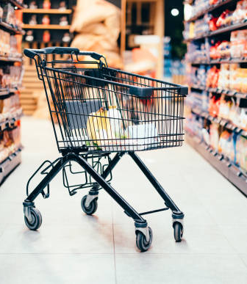


Presentation title
# 𝗖𝗼𝗱𝗲𝗯𝗮𝘀𝗶𝗰 𝗥𝗲𝘀𝘂𝗺𝗲 𝗖𝗵𝗮𝗹𝗹𝗲𝗻𝗴𝗲 9
AtliQ Mart
“Your One-Stop Shop for Exceptional Quality and Unmatched Convenience !”
Enhancing Sales Effectiveness: Conducting a Comprehensive Promotion Analysis to Deliver Actionable Insights to the Sales Director.
Presenter Name
Presented by :
Pooja Poundkar

Slide 2
Agenda
Introduction
Problem
Statement
Analysis Goals
Ad-Hock Business Requests
Insights &
Recommendation
Dashboard

Slide 3

Introduction
AtliQ Mart, with its 50 stores across major cities like Bengaluru, Chennai, Hyderabad, Mysuru and more, offered great discounts on AtliQ branded products during Diwali 2023 and Sankranti 2024.
The festive seasons of Diwali 2023 and Sankranti 2024 saw AtliQ Mart's 50 retail outlets host a huge promotion, making quality products more accessible to customers.
3
This Photo by Unknown Author is licensed under CC BY
This Photo by Unknown Author is licensed under CC BY-SA

Slide 4




Problem Statement :
AtliQ Mart, a leading retail chain with 50 outlets across southern India, ran substantial Diwali 2023 and Sankranti 2024 promotions on their AtliQ brand.
The Sales Director needs a thorough evaluation to differentiate successful promotions from those that underperformed.
The aim is to pinpoint effective strategies and refine future promotional campaigns for optimum results.
4

Slide 5
Analysis Goals :
Generate SQL-based reports to address critical business inquiries posed by senior executives.
Develop a dashboard showcasing key performance indicator (KPI) metrics and evaluate performance.
Produce a presentation and present findings to the Sales Director.
5

Slide 6

Ad-Hoc Business Requests

Slide 7
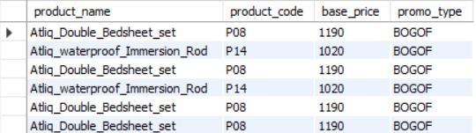

Provide a list of products with a base price greater than 500 and that are featured in promo type of 'BOGOF' (Buy One Get One Free). This information will help us identify high-value products that are currently being heavily discounted, which can be useful for evaluating our pricing and promotion strategies
select p.product_name,f.product_code,f.base_price,f.promo_type
from dim_products p
join fact_events f
on p.product_code=f.product_code
where f.base_price>500 AND f.promo_type="BOGOF";
At AtliQ Mart, the Double Bedsheet Set (₹1190) and Waterproof Immersion Rod (₹1020) are stand-out high-value products, presently being offered with substantial discounts through 'BOGOF' promotions.

Slide 8
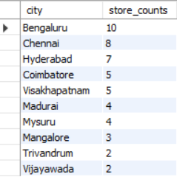
2. Generate a report that provides an overview of the number of stores in each city. The results will be sorted in descending order of store counts, allowing us to identify the cities with the highest store presence. The report includes two essential fields: city and store count, which will assist in optimizing our retail operations.
select
city, count(distinct store_id) as store_counts
from dim_stores
group by city
order by store_counts desc ;
Bengaluru, Chennai, and Hyderabad, the top three cities, collectively account for 50% of the total stores in the southern region of India.

Slide 9

3. Generate a report that displays each campaign along with the total revenue generated before and after the campaign? The report includes three key fields: campaign name, total revenue(before_promotion), total revenue(after promotion). This report should help in evaluating the financial impact of our promotional campaigns. (Display the values in millions)
WITH PromoPrices AS (
SELECT fe.*,
CASE WHEN fe.promo_type = '50% OFF' THEN fe.base_price * 0.5
WHEN fe.promo_type = '33% OFF' THEN fe.base_price * 0.67
WHEN fe.promo_type = '25% OFF' THEN fe.base_price * 0.75
WHEN fe.promo_type = '500 Cashback' THEN fe.base_price – 500
WHEN fe.promo_type = 'BOGOF' THEN fe.base_price / 2
ELSE fe.base_price
END AS promo_price
FROM
fact_events fe
)
SELECT
dc.campaign_name,
ROUND(SUM(f.`quantity_sold(before_promo)` * f.base_price) / 1000000, 2) AS total_revenue_before_promotion,
ROUND(SUM(f.`quantity_sold(after_promo)` * p.promo_price) / 1000000, 2) AS total_revenue_after_promotion
FROM dim_campaigns dc
JOIN fact_events f ON dc.campaign_id = f.campaign_id
JOIN PromoPrices p ON p.event_id = f.event_id
GROUP BY dc.campaign_name;
In the Diwali campaign, the total revenue soared from 83M to 207M post-promotion, signifying an impressive 151% surge.
During the Sankranti campaign, the total revenue surged from 58M to 140M after the promotion, demonstrating a notable 141% increase.

Slide 10
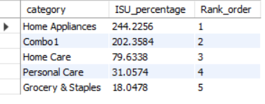
4. Produce a report that calculates the Incremental Sold Quantity (ISU%) for each category during the Diwali campaign. Additionally, provide rankings for the categories based on their ISU%. The report will include three key fields: category, isu%, and rank order. This information will assist in assessing the category-wise success and impact of the Diwali campaign on incremental sales.
SELECT
p.category,
((SUM(f.`quantity_sold(after_promo)`)-SUM(f.`quantity_sold(before_promo)`))/SUM(f.`quantity_sold(before_promo)`) * 100) AS ISU_percentage , RANK()
OVER (ORDER BY((SUM(f.`quantity_sold(after_promo)`)-SUM(f.`quantity_sold(before_promo)`)) / SUM(f.`quantity_sold(before_promo)`) * 100) DESC) AS Rank_order
FROM dim_products p
JOIN fact_events f
ON p.product_code = f.product_code
WHERE f.campaign_id = 'CAMP_DIW_01’
GROUP BY p.category
ORDER BY ISU_percentage DESC;
Home appliances experienced the highest Incremental Sold Quantity (ISU%) of 244%, indicating that products in this category were particularly popular during the Diwali campaign.
The top three categories based on ISU% are home appliances, combo 1, and home care, with impressive increases of 244%, 202%, and 79%, respectively.

Slide 11
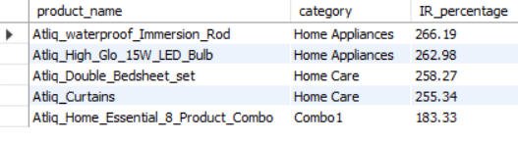
5. Create a report featuring the Top 5 products, ranked by Incremental Revenue Percentage (IR%), across all campaigns. The report will provide essential information including product name, category, and ir%. This analysis helps identify the most successful products in terms of incremental revenue across our campaigns, assisting in product optimization.
SELECT
p.product_name, p.category,
round((
(SUM(f.base_price * f.`quantity_sold(after_promo)`) - SUM(f.base_price * f.`quantity_sold(before_promo)`)) / SUM(f.base_price * f.`quantity_sold(before_promo)`)
) * 100 ,2) AS IR_percentage
FROM
dim_products p
JOIN
fact_events f
ON p.product_code = f.product_code
GROUP BY
p.product_name, p.category
ORDER BY
IR_percentage DES
CLIMIT 5;
Waterproof Immersion Rod, LED Bulb, Bedsheet Set, Curtains, and Home Essential Product Combo have ranked as the top five products based on their Incremental Revenue Percentage (IR%) across all campaigns at AtliQ Mart.

Slide 12

DASHBOARD FOR ATLIQ MART

Slide 13
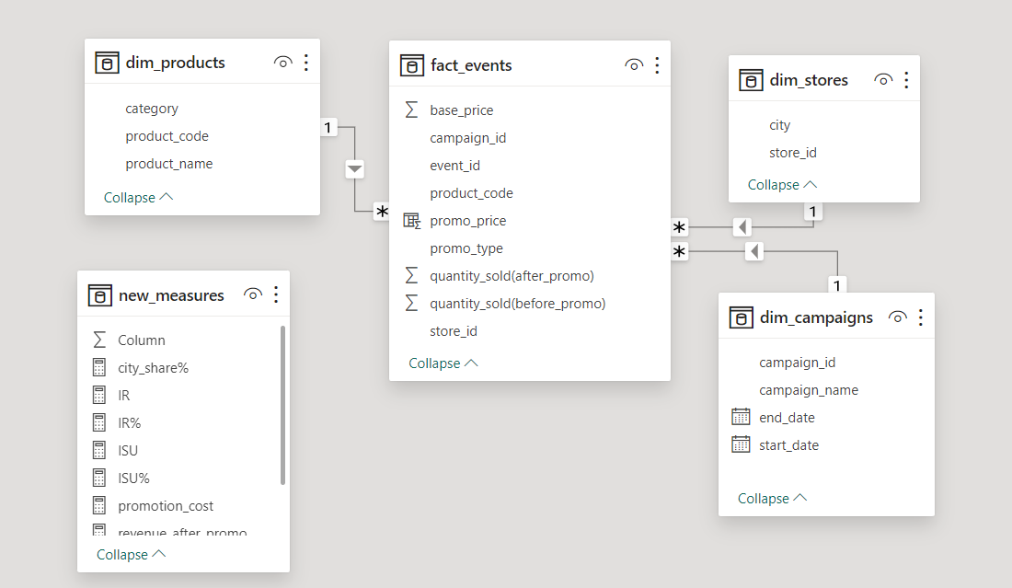
Data Model View

Slide 14
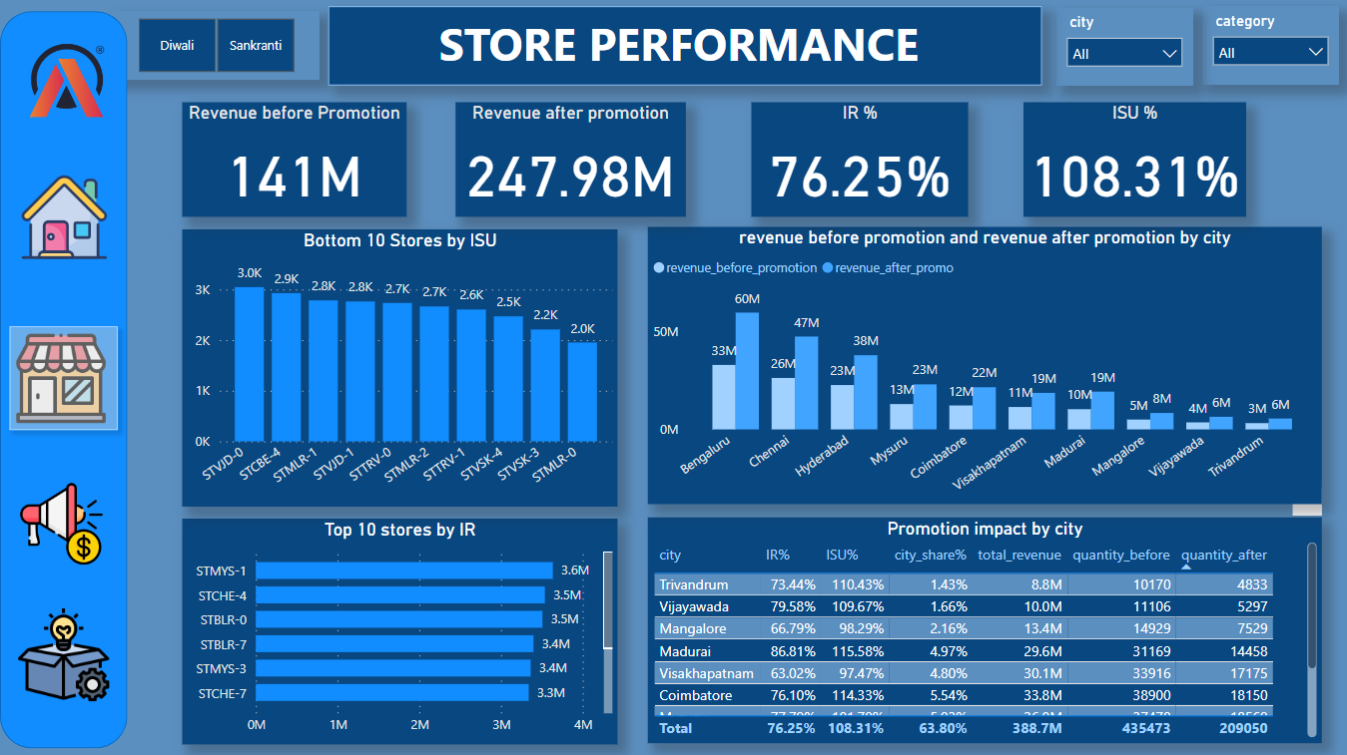
2.

Slide 15
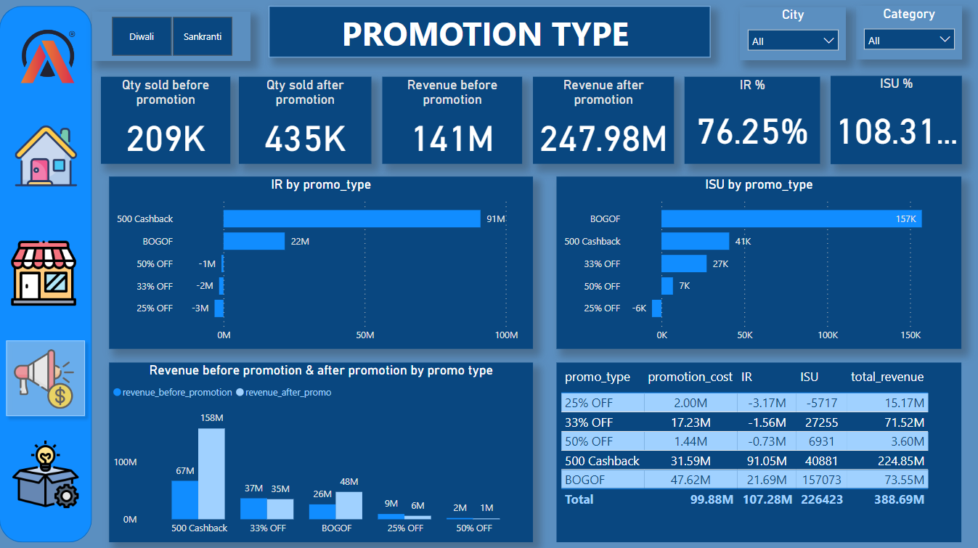
2.

Slide 16
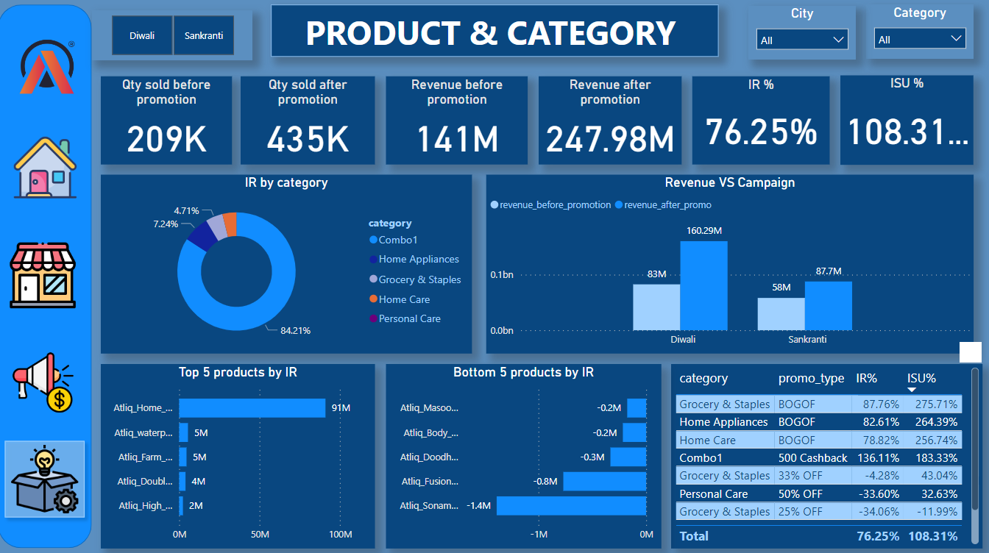
2.

Slide 17
Insights :
The store STMYS-1 leads in IR with 3.6M orders, followed by STCHE-4 and STBLR-0 with 3.5M orders each, showcasing potential efficiency in sales processes.
The presence of STMLR-0 and STVSK-3 in the bottom 10 stores by ISU with only 2.0K and 2.2K respective orders suggests a potential for improvement in their sales strategies or market targeting.
The total sales and revenue in Bengaluru, Chennai, and Hyderabad collectively contribute to more than 58% of the total sales and revenue in the southern region of India.
Promotions offering cashback (500 cashback) have the highest IR at 91 million, indicating a strong customer attraction. Conversely, promotions like 50% off, 33% off, and 25% off have negative IR, suggesting a potential misalignment between these discounts and customer preferences or market demands.
BOGOF and 500 Cashback promotions lead with positive ISU, indicating effectiveness in driving incremental sales, whereas 33% off and 50% off have lower ISU, suggesting they may not be as impactful. 25% off shows a negative ISU, indicating it may not be resonating with customers.
500 Cashback" and "BOGOF" promotions led to significant revenue boosts, while "25%" and "50%" promotions resulted in declines, highlighting the varying effectiveness of different promotional strategies in driving sales.
17

Slide 18
Insights :
Combo1 has the highest IR at 84.21%, indicating high incremental revenue potential. Home appliances and grocery & staples show lower IRs at 7.24% and 4.71% respectively, suggesting a lower revenue potential compared to Combo1.
During the Diwali campaign, revenue increased by approximately 93.67% from 83M to 160.29M post-promotion, while during Sankranti, revenue increased by approximately 51.55% from 58M to 87.7M post-promotion, indicating the significant impact of promotions during festive periods.
The promotions offering the highest IR% and ISU% are "500 Cashback" and "BOGOF," indicating their effectiveness in driving incremental sales and revenue. Conversely, "25% OFF" and "50% OFF" show negative IR% and ISU%, suggesting that these promotions are not resonating well with customers or may not be aligned with market demand.
18

Slide 19
recommendation :
Despite having fewer stores, Madurai and Coimbatore generate higher revenue compared to Bengaluru, Chennai, and Hyderabad. The reasons behind this disparity need to be investigated.
The introduction of the BOGOF offer on high-priced products led to a notable sales spike, increasing by up to 300%. However, the reason why these products were not initially the primary choice for customers needs to be determined.
The most sold products fall under the Home Appliances category and combo offers. However, there is an opportunity to increase focus on the Grocery & Staples category.
19

Slide 20









Thank you
poojapoundkar1995@gmail.com
https://codebasics.io/portfolio/Pooja-Poundkar
https://www.linkedin.com/in/pooja-poundkar/
https://github.com/poojapoundkar

